Slide 1
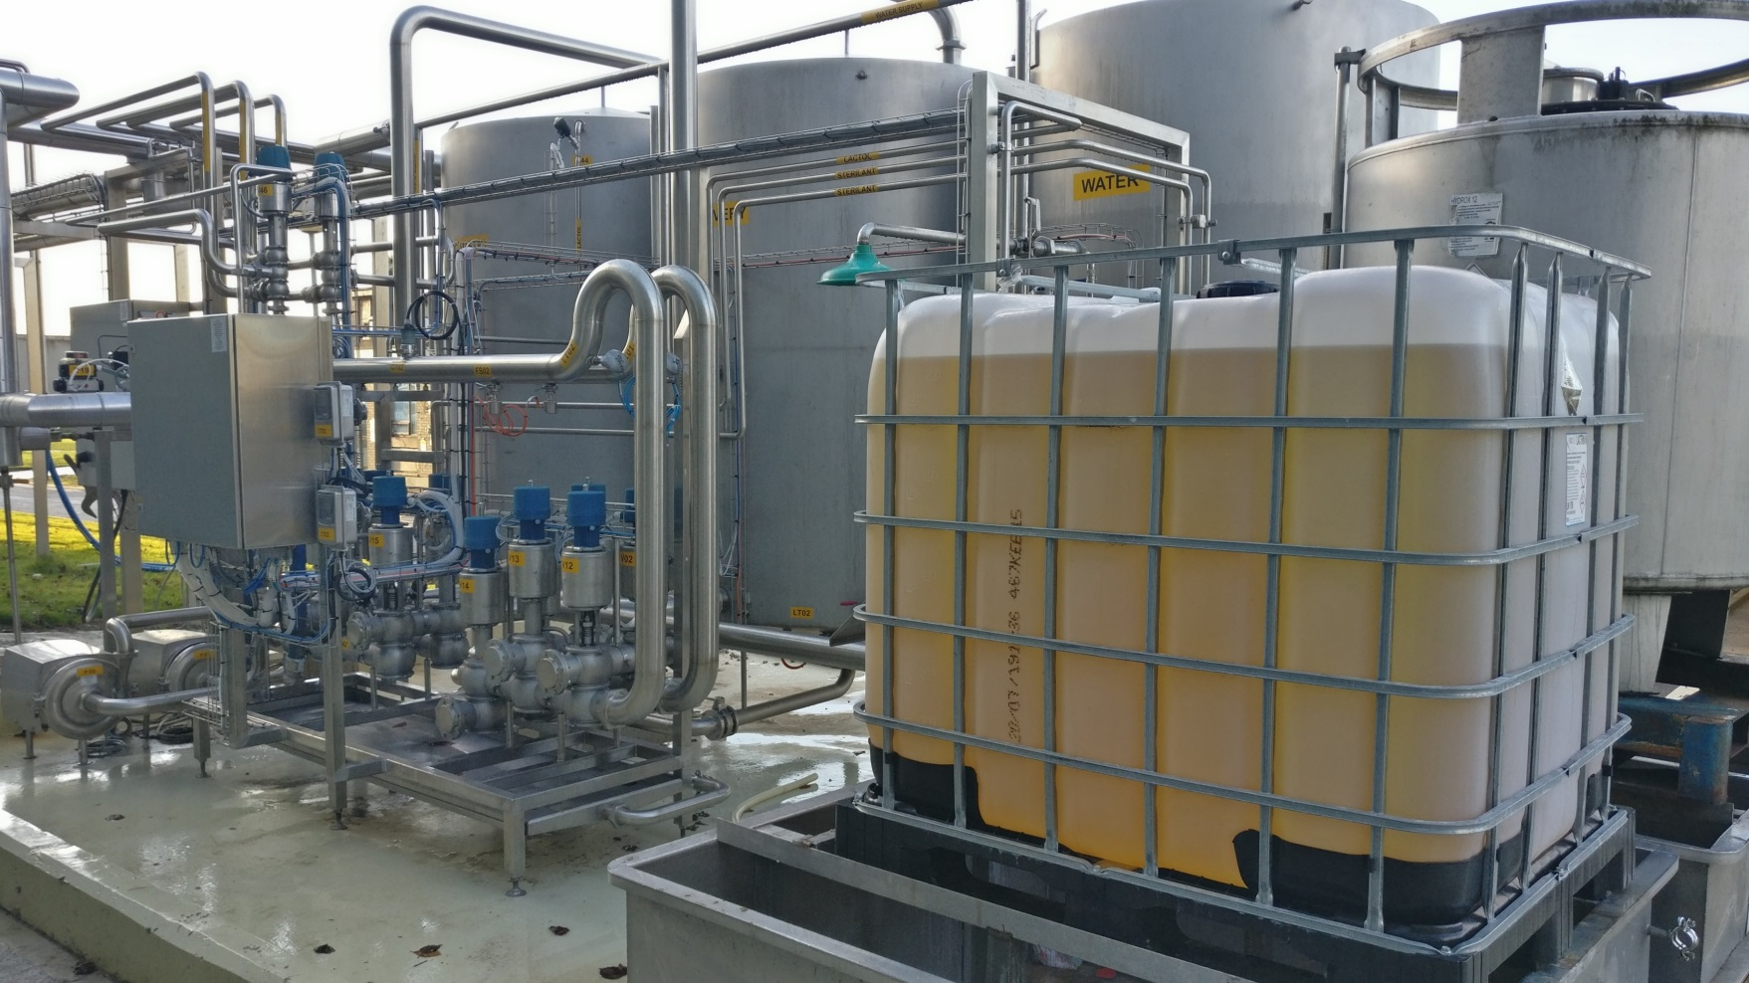


SmartCIP Demonstration Project
This project has received funding from the European Union’s H2020 research and innovation programme under grant agreement No 77789
Notes:
SmartCIP is the acronym for a project demonstrating a technology for the recovery,
remediation and multiple re-use of sodium hydroxide based detergents in Cleaning-in-Place (CIP) systems
that are operated in the dairy, food and beverage industries. It addresses the market needs for
innovative, sustainable and smart solutions to reduce the cost base & carbon footprint of these sectors

Slide 2
SmartCIP - Target
CIP solution regeneration
Reduce valuable CIP solution loss
Reduce water usage
Optimise cleaning efficacy
Improve effluent plant operation
Standardise CIP
Reduce hydraulic loading
Reduce transport

Slide 3







SmartCIP Demonstration Project
Project Partners
Notes:
Moorepark Technology Ltd (MTL) in Fermoy, Co Cork , one of two DIVA registered food demonstration sites in Europe, is the location the SmartCIP project. The Project Lead, with responsibility for managing the project is 2eTechnical Development Ltd The design partner for the innovative detergent remediation unit was FTRJ in Germany and the plant was fabricated by SME partner Andeas Junghans Anlagenbau und Edelstahlbearbeitung GmbH. Spanish SME, Bionet Servicios Tecnicos SL were the automation and software partner. Technical ceramics company Rauschert Kloster Veilsdorf GmbH and Lakeland Dairies were project sponsors. Specialist ceramic filtration membranes were manufactured by Inopor GmbH. The remediation unit, which was installed in a 20’ shipping container was transported to Moorepark and integrated into the Cleaning-in-Place plant for the MTL pilot-scale milk processing plant. Control Integration Design Ltd were the sub-contractor for Process, Electrical and Automation engineering integration. Bionet Servicios Tecnicos SL (Spain) were the automation and software partner.

Slide 4
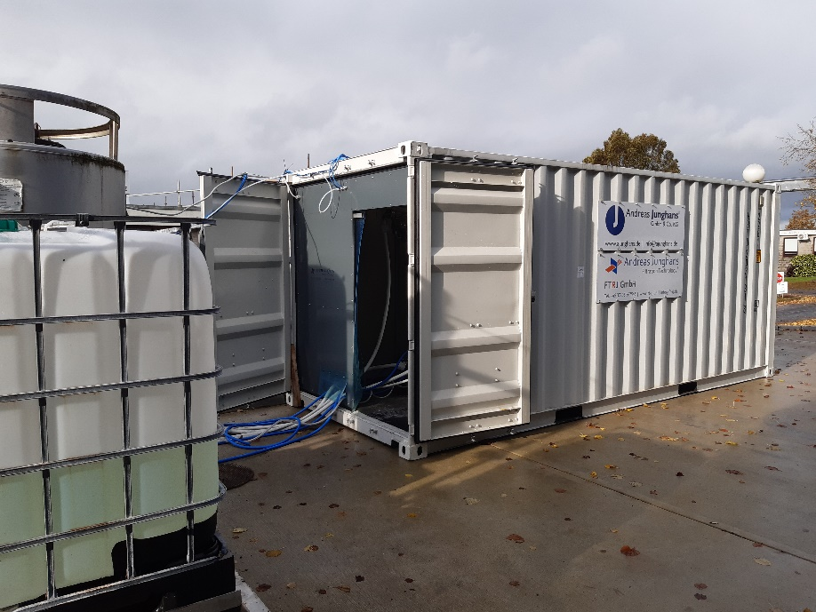
Skid Mounted Membrane System
Easy installation
Self-cleaning
Quick-Fit
Notes:
The remediation unit, which was installed in a 20’ shipping container, was transported to Moorepark and integrated into the Cleaning-in-Place plant for the MTL pilot-scale milk processing plant. Control Integration Design Ltd were the sub-contractor for Process, Electrical and Automation engineering integration.

Slide 5
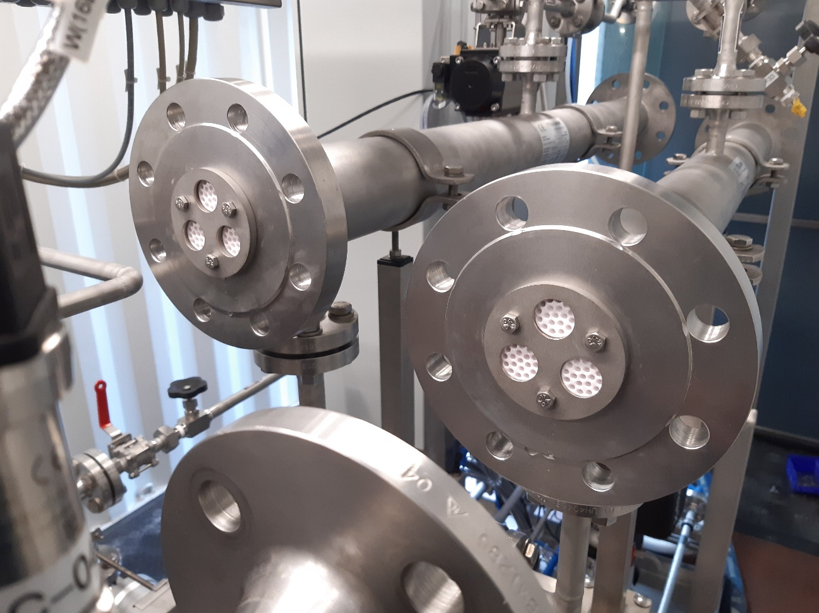
SmartCIP Demonstration Project
Technology Platform
Robust membrane
Long-life
Custom design
No waste
Selective removal of suspended and soluble organic matter
Soiled > high clarity Caustic Detergent
Notes:
The specific objectives of the project are to demonstrate the technico-economic feasibility,
operational robustness & efficacy and sustainability impact of the retrofitted system at MTL.

Slide 6
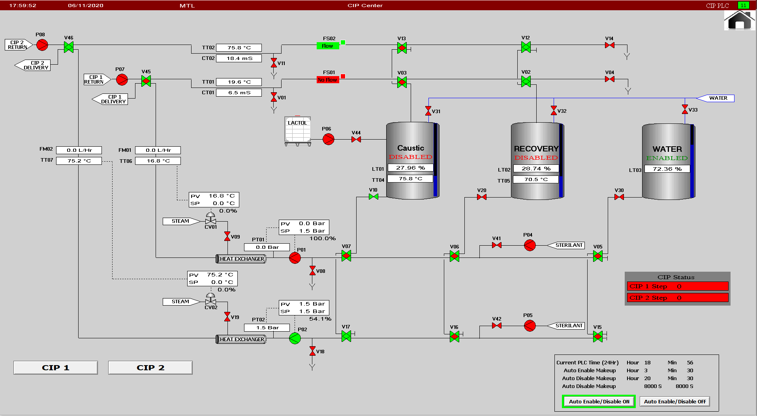
Notes:
The MTL CIP pant is a replica of the type of centralised and automated CIP system found in large scale milk processing plants in Ireland and internationally. In the SmartCIP system, used cleaning detergent is collected in a Recovery Tank and purified by filtering out the suspended soluble organic residues produced during the internal cleaning of pipes , vessels and various equipment items, using specialised ceramic membranes. The purified detergent is pumped to the Caustic tanks for re-use.

Slide 7
Retrofit
Simple Integration
Remote access
Notes:
Digital sensors for electrical conductivity, turbidity, flowrate, level measurement, pressure and temperature are incorporated in the filtration plant to enable automatic supervisory process control and data acquisition for plant management and quality assurance. The plant can be operated from a human machine interface (HMI) touchscreen on the control panel or from the central process control room in the factory

Slide 8
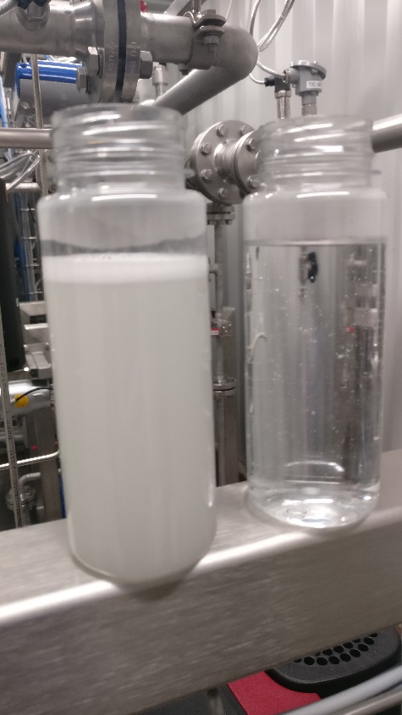
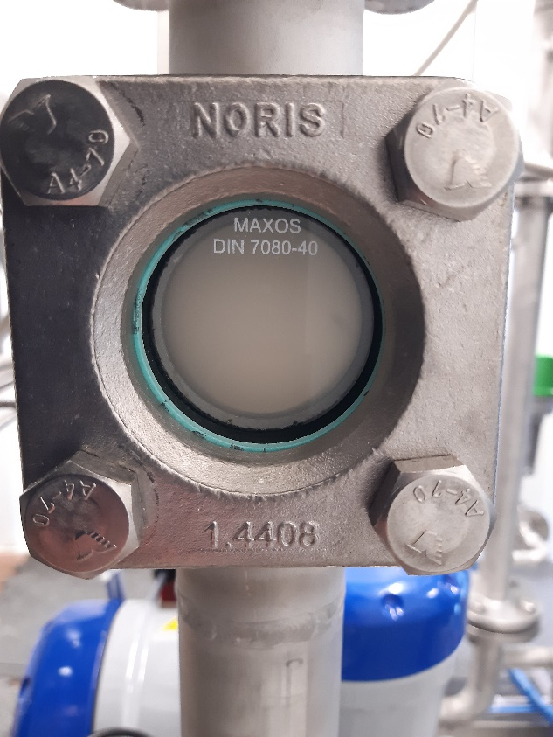
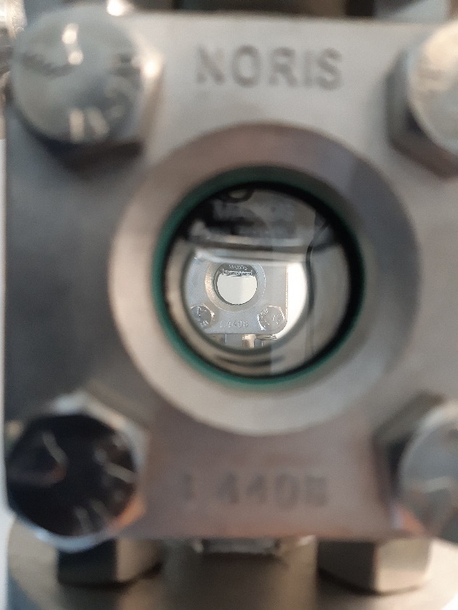

Clean solution – clean plant
Notes:
The SmartCIP system was commissioned during October and has been operational since the beginning of November.
Early results have been very promising with the efficient production of high purity remediated detergent of excellent clarity.

Slide 9
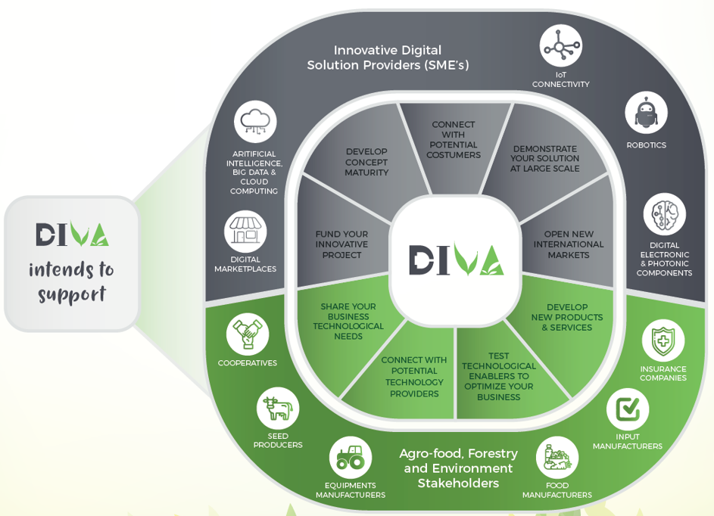
SmartCIP Demonstration Project
To book a trial demonstration
Please contact Kieran Downey
ACKNOWLEDGEMENT
EU Project DIVA aims to support the emergence and development of new industrial digitech value chains with applications to the agro-food, forestry and environment sectors
This project has received funding from the European Union’s H2020 research and innovation programme under grant agreement No 77789

